Slide 1

Introduction to Database Systems

Slide 2

Some common uses of database systems.
Characteristics of file-based systems.
Problems with file-based approach.
Meaning of the term database.
Meaning of the term Database Management System (DBMS).

Slide 3

Typical functions of a DBMS.
Major components of the DBMS environment.
Personnel involved in the DBMS environment.
History of the development of DBMSs.
Advantages and disadvantages of DBMSs.

Slide 4

Purchases from the supermarket
Purchases using your credit card
Booking a holiday at the travel agents
Using the local library
Taking out insurance
Using the Internet
Studying at university

Slide 5
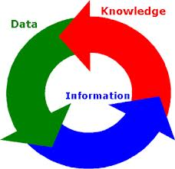

Data
Information
Knowledge
Database (DB), Knowledge Base (KB)
System
Database System, Information System, Knowledge-based System, Decision Support System
Metadata
Database Management System (DBMS)

Slide 6

Representation of observations or concepts suitable for communication, interpretation, and processing by humans or machines.
Datum (from Latin; plural: data) given
Facts, text, graphical symbols, sound that have meaning

Slide 7


Data that have been processed and can be used for a decision making
Information = processed(data) + purpose
Information = data + meaning

Slide 8

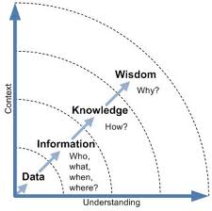
Image taken from http://www.cioupdate.com/cio-insights/implementing-knowledge-management-part-i-concepts-approach-1.html

Slide 9

“Informatics is the science of information. It studies the representation, processing, and communication of information in natural and artificial systems.
Since computers, individuals and organizations all process information, informatics has computational, cognitive and social aspects.
Used as a compound, in conjunction with the name of a discipline, as in medical informatics, bioinformatics, etc., it denotes the specialization of informatics to the management and processing of data, information and knowledge in the named discipline.”
Source: http://www.inf.ed.ac.uk/publications/online/0139.pdf

Slide 10
Medical Informatics
Health Informatics
Biomedical Informatics
  definition
Bioinformatics

Slide 11

A database is a self-describing collection of integrated records (M. Kroenke)
Collection of related data

Slide 12

Meta – a prefix that means about
Metalanguage –language describing other language
Metadata – data about data; for example: data definition, data structure, rules, authorization, and constraints.
Examples: Birthdate

Slide 13

Database Management System
Software system that enable users to define, create, maintain, and control access to the database (textbook)

Slide 14

Collection of application programs that perform services for the end users (e.g. reports).
Each program defines and manages its own data.

Slide 15

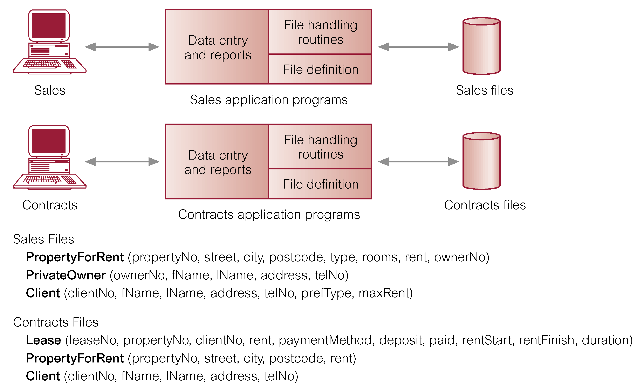

Slide 16

Separation and isolation of data
  Each program maintains its own set of data.
  Users of one program may be unaware of potentially useful data held by other programs.
Duplication of data
  Same data is held by different programs.
  Wasted space and potentially different values and/or different formats for the same item.

Slide 17
Data dependence
  File structure is defined in the program code.
Incompatible file formats
  Programs are written in different languages, and so cannot easily access each other’s files.
Fixed Queries/Proliferation of application programs
  Programs are written to satisfy particular functions.
  Any new requirement needs a new program.

Slide 18

Arose because:
  Definition of data was embedded in application programs, rather than being stored separately and independently.
  No control over access and manipulation of data beyond that imposed by application programs.
Result:
  the database and Database Management System (DBMS).

Slide 19
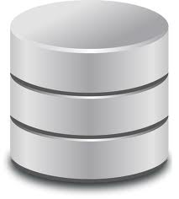

Shared collection of logically related data (and a description of this data), designed to meet the information needs of an organization.
System catalog (metadata) provides description of data to enable program–data independence.
Logically related data comprises entities, attributes, and relationships of an organization’s information.

Slide 20

A software system that enables users to define, create, and maintain the database and that provides controlled access to this database.

Slide 21
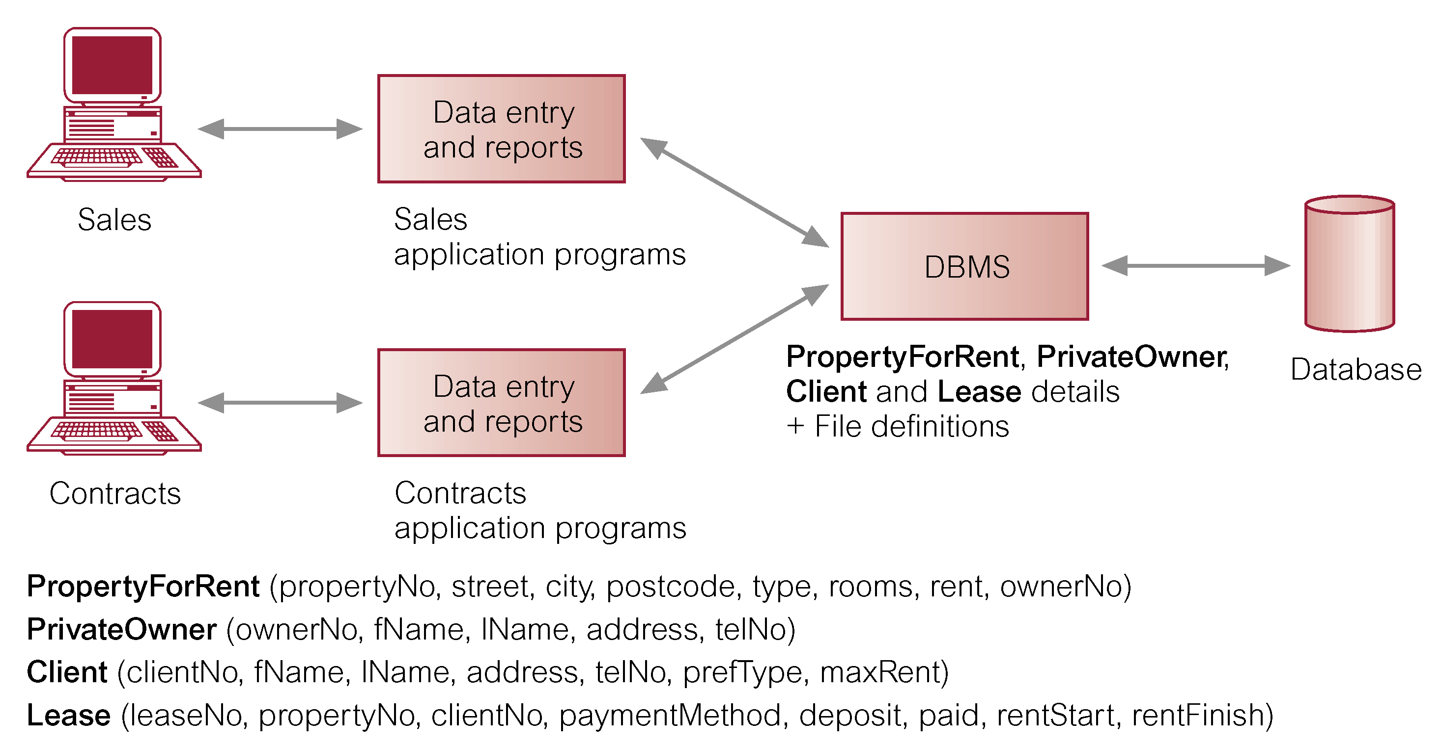

Slide 22
Data definition language (DDL).
  Permits specification of data types, structures and any data constraints.
  All specifications are stored in the database.
Data manipulation language (DML).
  General enquiry facility (query language) of the data.

Slide 23
Controlled access to database may include:
  A security system.
  An integrity system.
  A concurrency control system.
  A recovery control system.
  A user-accessible catalog.
A view mechanism.
  Provides users with only the data they want or need to use.

Slide 24

Allows each user to have his or her own view of the database.
A view is essentially some subset of the database.

Slide 25
Benefits include:
  Reduce complexity;
  Provide a level of security;
  Provide a mechanism to customize the appearance of the database;
  Present a consistent, unchanging picture of the structure of the database, even if the underlying database is changed.

Slide 26

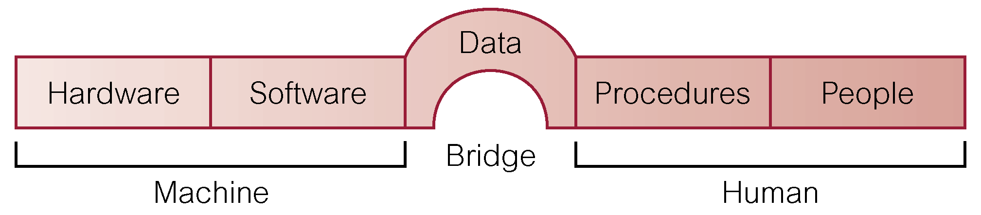

Slide 27
Hardware
  Can range from a PC to a network of computers.
Software
  DBMS, operating system, network software (if necessary) and also the application programs.
Data
  Used by the organization and a description of this data called the schema.

Slide 28
Procedures
  Instructions and rules that should be applied to the design and use of the database and DBMS.
People

Slide 29

Data Administrator (DA)
Database Administrator (DBA)
Database Designers (Logical and Physical)
Application Programmers
End Users (naive and sophisticated)

Slide 30

First-generation
  Hierarchical (IMS) and Network (IDS, IDMS) (1960s)
Second generation (1970s)
  Relational (RDBMS)
Third generation (1980s)
  Object Relational (ORDBMS)
  Object-Oriented (OODBMS)
  Please study section 1.5 from chapter 1 – we will cover this material in more depth through the course.

Slide 31

Control of data redundancy
Data consistency
More information from the same amount of data
Sharing of data
Improved data integrity
Improved security
Enforcement of standards
Economy of scale

Slide 32
Balanced conflicting requirements
Improved data accessibility and responsiveness
Increased productivity
Improved maintenance through data independence
Increased concurrency
Improved backup and recovery services

Slide 33

Complexity
Size
Cost of DBMS
Additional hardware costs
Cost of conversion
Performance
Higher impact of a failure

